Slide 1
Income Classification Model
Predicting Income Levels Using Machine Learning
Objective: To develop a machine learning model that predicts whether an individual’s income exceeds $50,000 per year, based on demographic and work-related factors.
Key Goals:
Identify drivers of higher income
Understand socio-economic patterns
Build a predictive model for income classification
Dataset Summary:
Records: 32,561
Features: 15 (Age, Education, Occupation, Gender, Hours-per-week, Capital-gain, etc.)
Target: Income (≤50K / >50K)
Tools & Libraries Used: Python, Pandas, Seaborn, Plotly, XGBoost, Scikit-learn, SMOTE
Pipeline Overview: → Data Cleaning → EDA → Feature Encoding → Random Forest → XGBoost (Tuned) → Insights
Pavan Choudhary

Slide 2
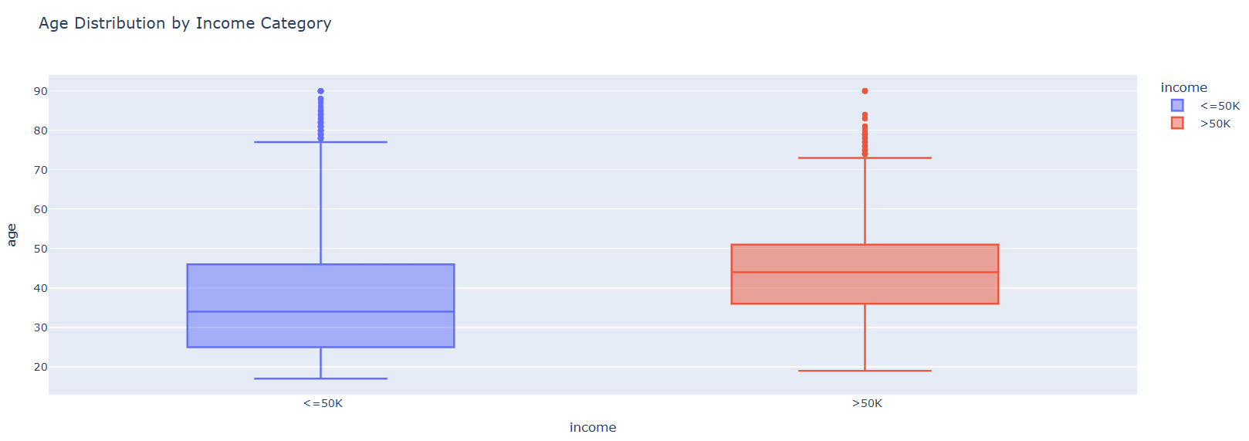
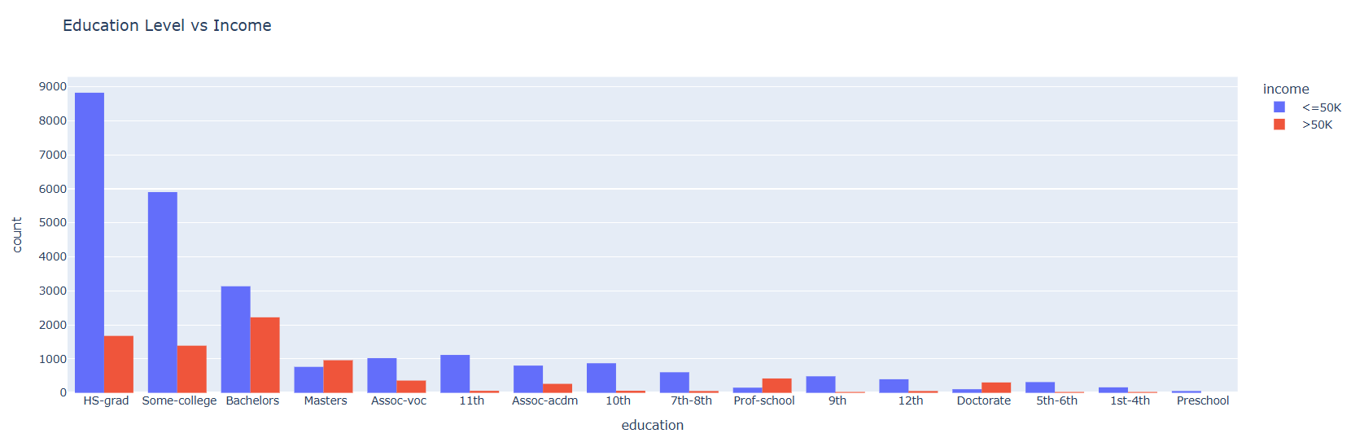
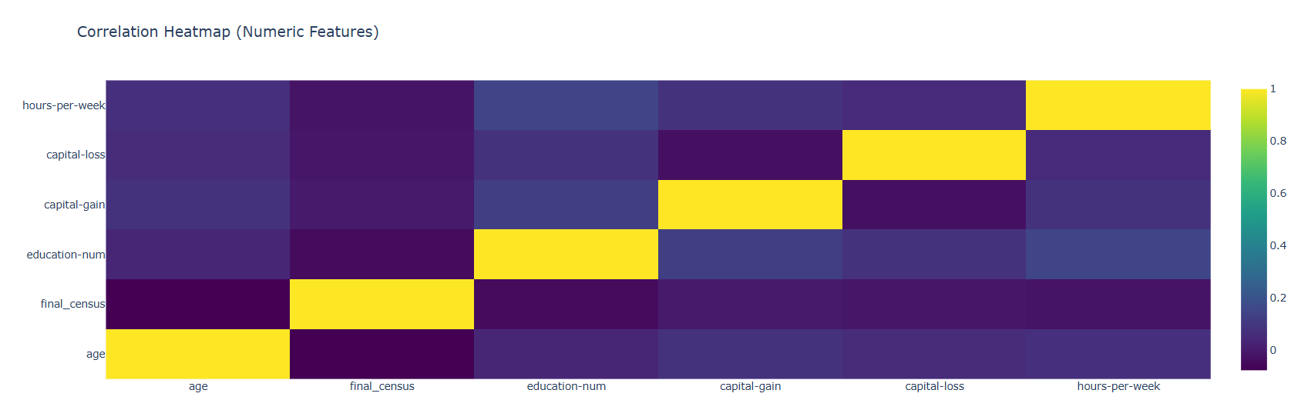
Exploratory Data Analysis (EDA)
Key Observations:
Aspect Insight
Income Distribution Dataset is imbalanced – majority ≤50K
Age vs Income Higher earners mostly between 30–55 years
Education Strong correlation – Bachelor’s, Master’s, Doctorate → >50K
Gender Males dominate >50K category → noticeable income gap
Hours-per-week >40 hours/week → significantly higher earnings
Capital Gain Strongly linked to >50K earners
Relationship & Married (“Husband/Wife”) more likely to earn Marital Status >50K
Country USA dominates high-income class
Key Takeaway: Education, capital gain, working hours, and age are the most important drivers of high income.
Pavan Choudhary

Slide 3
Model Building & Tuning
Baseline Model: Random Forest
Accuracy : 86%
Recall (>50K) : 0.64
Balanced but missed many high earners.
Optimized Model: XGBoost + SMOTE + GridSearchCV
Tuned for Recall (to catch >50K earners)
Best Parameters: {'colsample_bytree': 1.0, 'learning_rate': 0.05, 'max_depth': 6, 'n_estimators': 200, 'scale_pos_weight': 3, 'subsample': 0.8}
Performance Comparison:
Metric Random Forest Tuned XGBoost
Accuracy 0.86 0.78
Precision (>50K) 0.74 0.52
Recall (>50K) 0.64 0.93
F1 (>50K) 0.69 0.67
Interpretation:
The XGBoost model trades a bit of precision for much higher recall — ensuring that most high-income individuals are correctly identified.
Confusion Matrix Insight:
High recall → Most >50K cases identified 2. Slight overlap between mid-income profiles
Pavan Choudhary

Slide 4
Insights, Feature Importance & Conclusion
Top 10 Features Influencing Income (XGBoost):
1. Education-num
2. Capital-gain
3. Age
4. Hours-per-week
5. Marital-status
6. Occupation
7. Relationship
8. Profession Class
9. Gender
10. Country
Model Insights:
Education and experience are core income drivers
Capital gains signify wealth and investments
Longer working hours and professional roles raise earning potential
Gender and marital factors still show social disparities
Final Results:
Accuracy: 78%
Recall (>50K): 0.93
Balanced precision-recall tradeoff
Highly interpretable socio-economic model
Conclusion:
The optimized XGBoost model provides accurate and interpretable predictions of income levels.
It highlights the importance of education, work effort, and capital accumulation as key pathways to higher income.
Applications:
1. HR Analytics & Workforce Planning 2. Socio-economic Policy Analysis 3. Financial Targeting & Market Segmentation
Pavan Choudhary

